Slide 1
“BOOK RECOMMENDATION SYSTEM”
a project of
MACHINE LEARNING

Slide 2
“GROUP MEMBERS”
STUDENT NAME | STUDENT ID
Muhammad Abdullah Shahid | F2019027004
Muhammad Muzammal | F2019027042
Amina Ashfaq | F2019027010
Zirwa Waqar | F2019027028
Sidra Kalsoom | F2019027037

Slide 3
What is A Recommendation System?
Personalized Preferences.
Information Filtering Technique.
Selection of Interested.
System of Intelligence.
Information Overload Problem.

Slide 4
WHY?
Lot of Choices.
Selection of Interested Item.
Share Preferences.
Decision Making.

Slide 5
HOW?
“COLLABORATIVE FILTERING APPROACH”
Matches the people of similar taste.
“CONTENT-BASED APPROACH”
Based on the user’s History.

Slide 6
“APPLICATIONS”
Selecting Books and newspaper.
Selecting best Movies,
Selecting Restaurants.
Selecting Home Items.
Selecting Cloths Online.

Slide 7
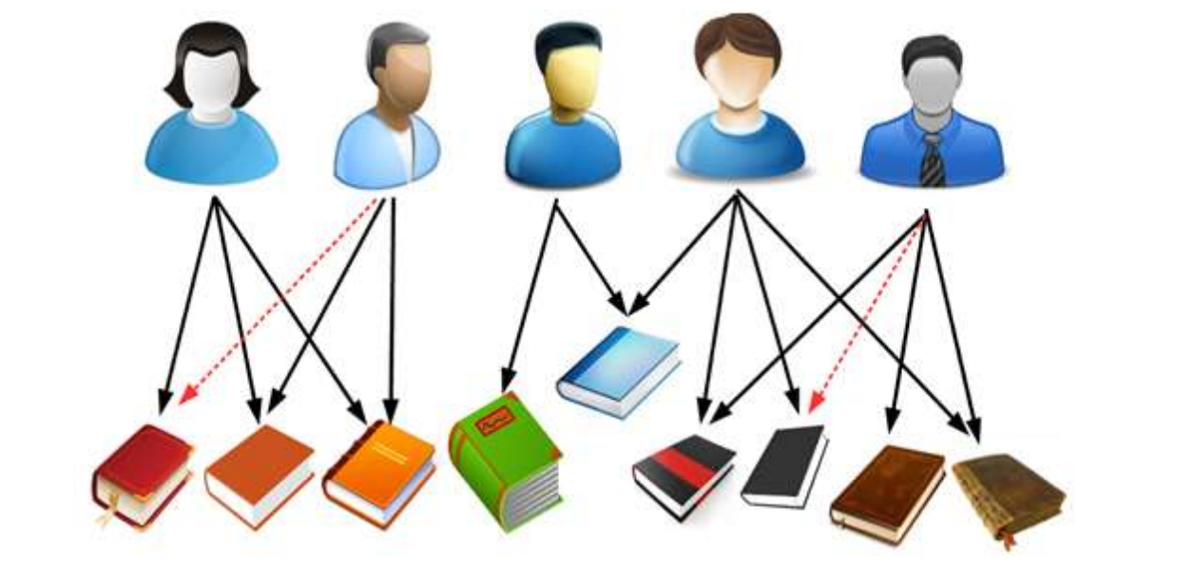
“OUR RECOMMENDATION SYSTEM”
“A BOOK RECOMMENDATION SYSTEM”

Slide 8
“Book Recommendation System” using “COLLABORATING FILTERING APPROACH”
Description Base Recommendation System
Rating And Review Base Recommendation System
Authors and Publisher Base Recommendation System

Slide 9
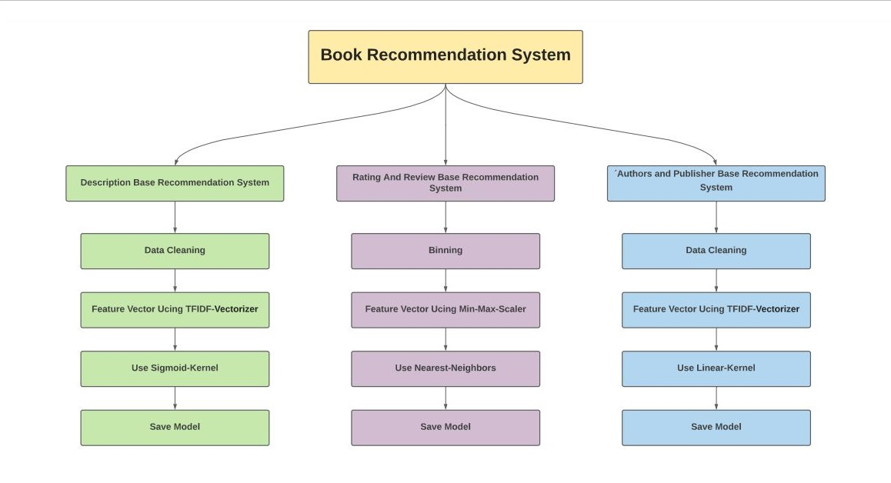

Slide 10
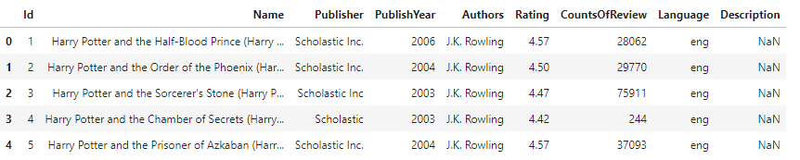
Used Dataset
Good Book Dataset (Kaggle)
Ten CSV Files
Nine unique Features
Shape of Dataset is (538282, 9)

Slide 11
“DESCRIPTION BASE RECOMMENDATION SYSTEM”
Work on Description column
Clean Data ( remove duplication, null values, stope words, punition, symbols etc.)
Convert info Feature Vector Using TFIDF-Vectorizer
Feature Unigram, Bigram, Trigram
Train Sigmoid-Kernel and Linear-Kernel
Reduce The Model Size
Save Trained Model

Slide 12
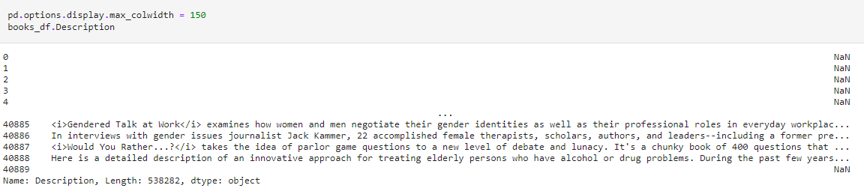
Work on Description column

Slide 13
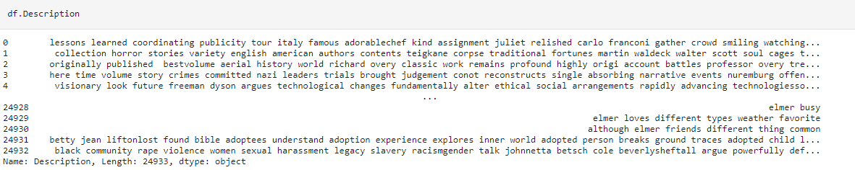
Clean Data

Slide 14
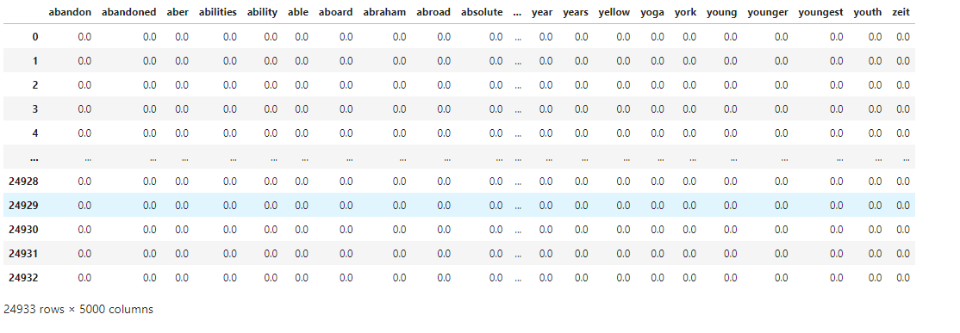
Convert info Feature Vector Using TFIDF -Vectorizer
Feature Unigram

Slide 15
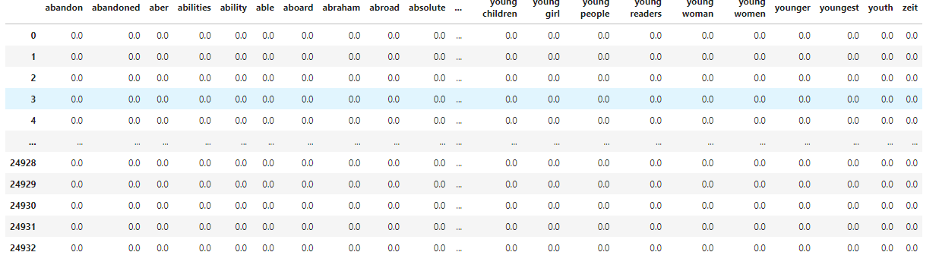
Feature Bigram

Slide 16
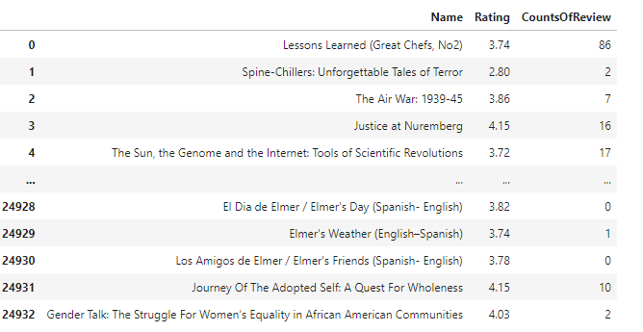
“RATING AND REVIEW BASE”
Work on Rating and Reviews columns
Convert Continues data in small Bins
Convert info Feature Vector Using Min-Max-Scaler
Find top Eleven Nearest Neighbors
Save Trained Model

Slide 17
“AUTHORS AND PUBLISHER BASE”
Work on Author and Publishers columns
Clean Data ( remove duplication, null values, stop words, punition, symbols etc.)
Feature char n-3 Gram
Train Linear-Kernel
Reduce The Model Size
Save Trained Model

Slide 18
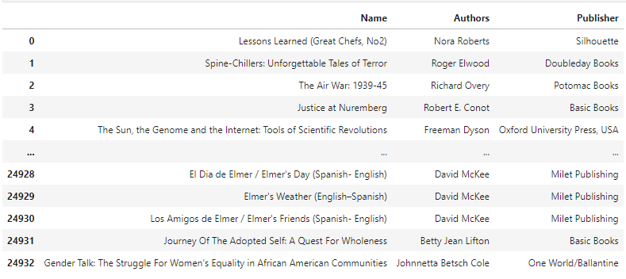
Work on Author and Publishers columns

Slide 19
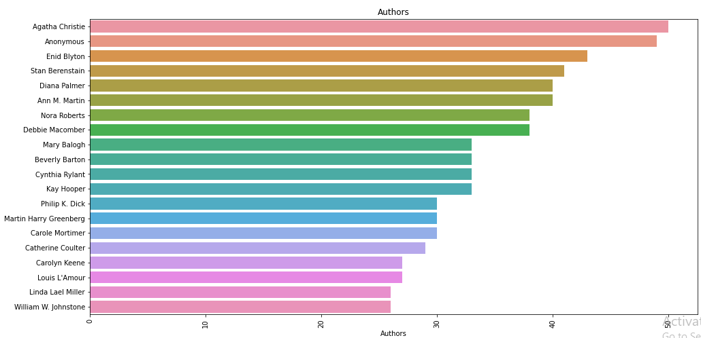
View Author Data

Slide 20
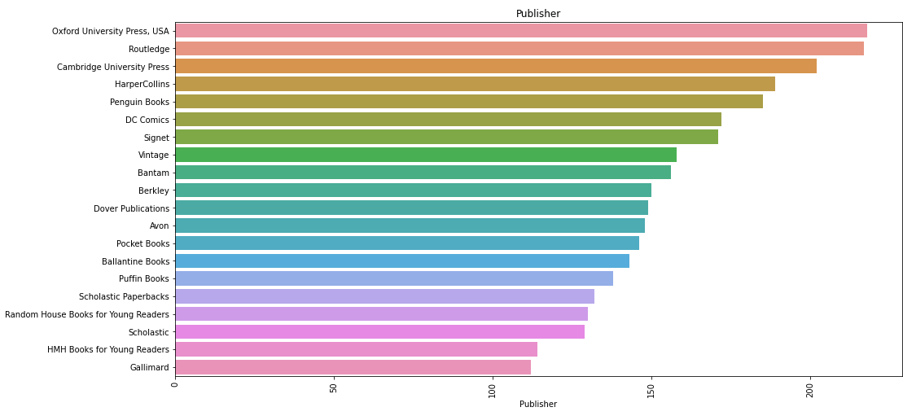
View Publisher Data

Slide 21
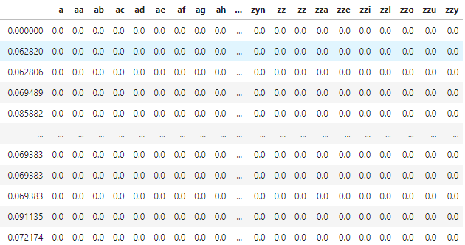
Feature char n-3 Gram

Slide 22
“LOADING AND TESTING OF TRAIN MODELS”
Use Pickle Library to Save and Load Train Model
Load All Trained Models
Define Function To Find Prediction
Test All Models

Slide 23
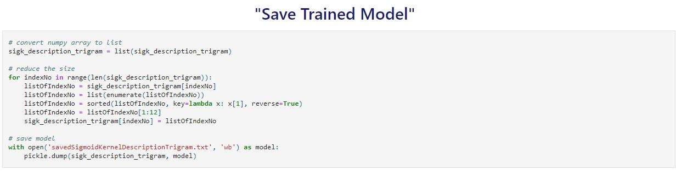
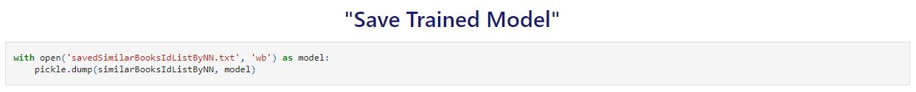
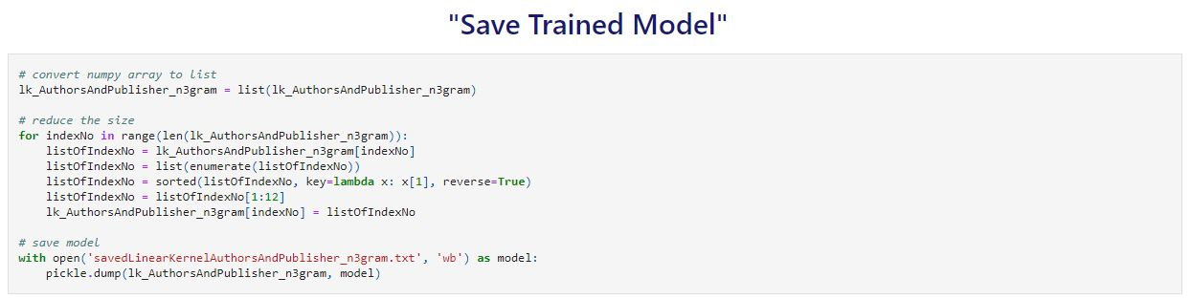

Slide 24
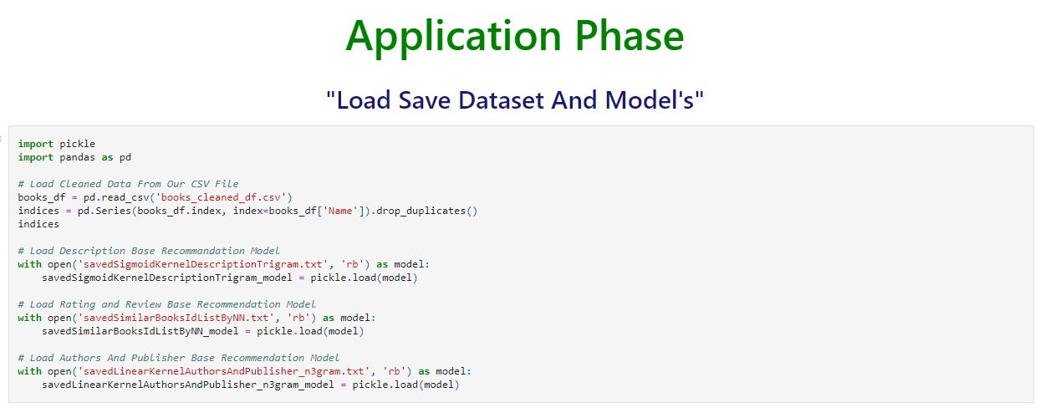

Slide 25
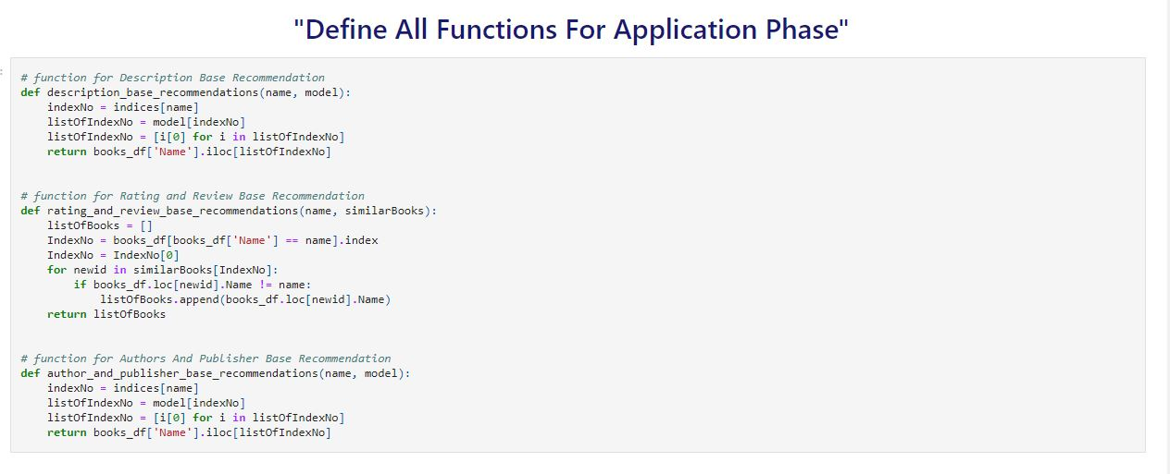

Slide 26
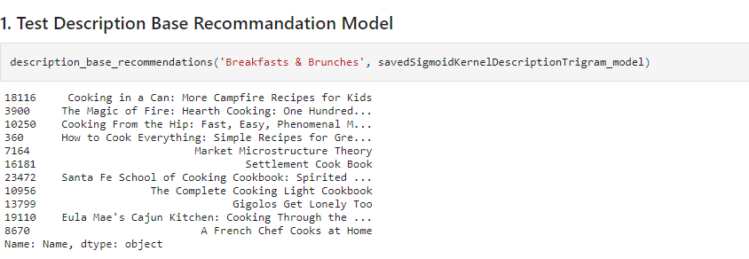
Test All Models

Slide 27
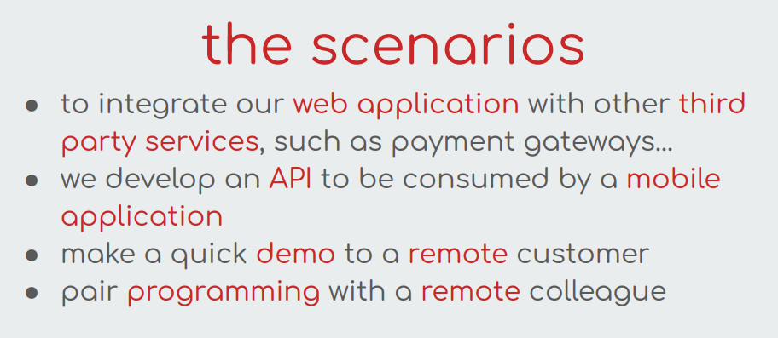
“Application Phase”

Slide 28
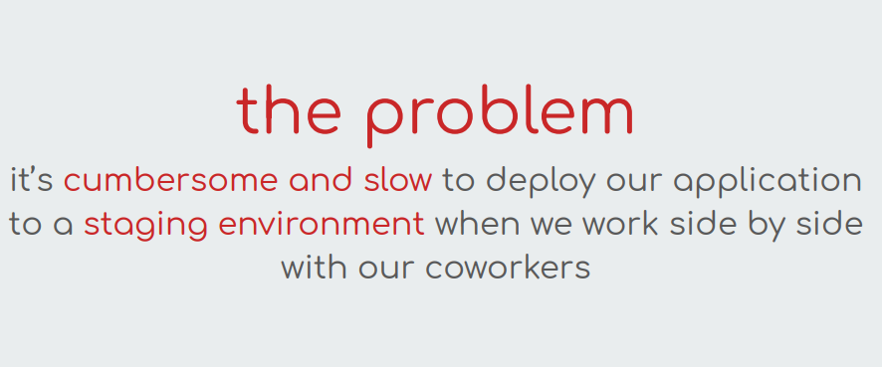

Slide 29
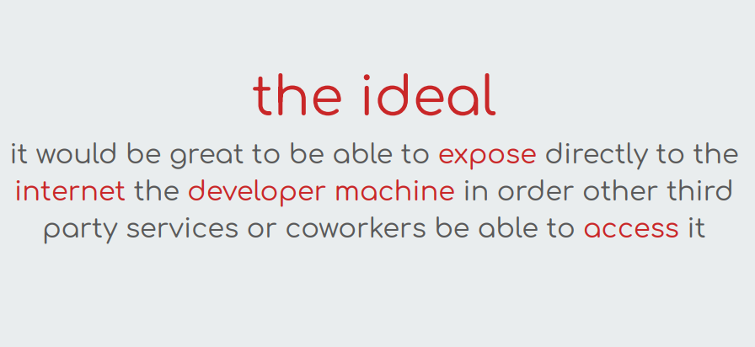

Slide 30


Slide 31
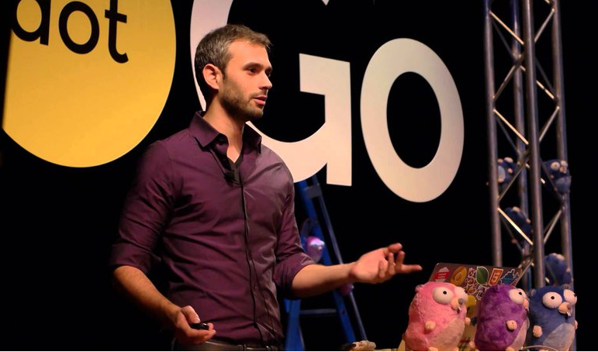
Alan Shreve Built ngrok Using Go

Slide 32
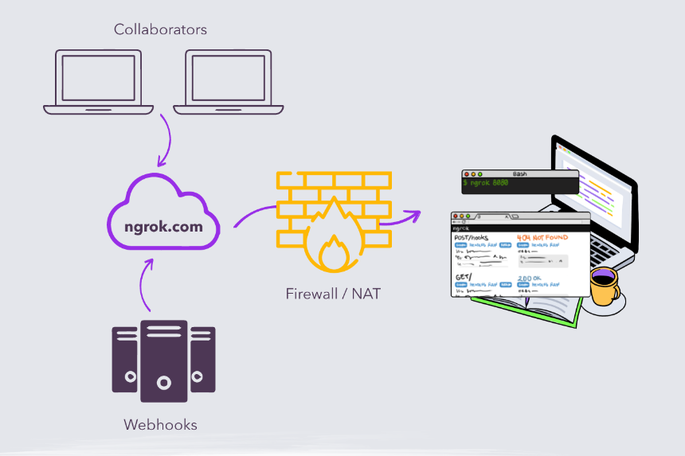

Slide 33
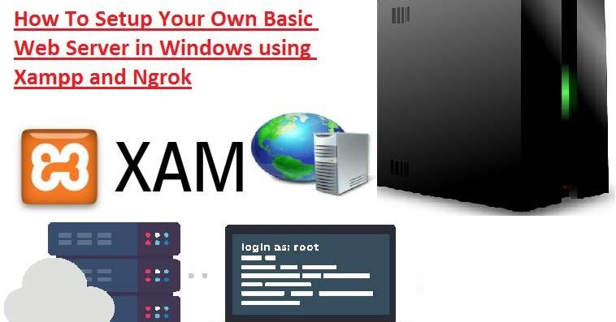

Slide 34
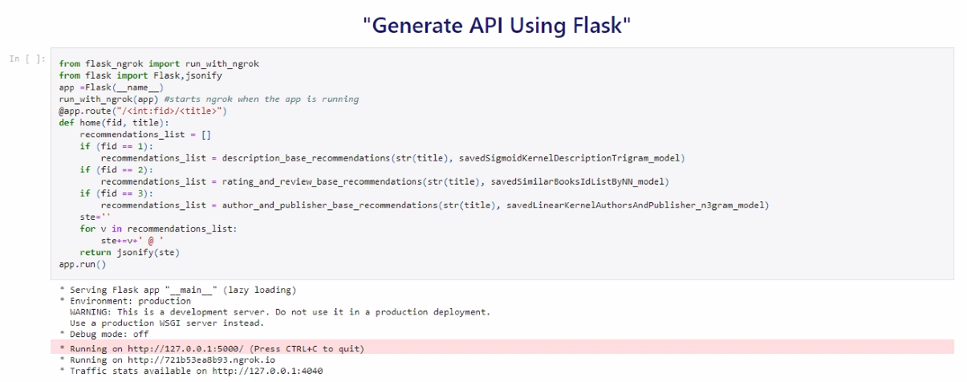

Slide 35
“Application Phase”
Use Flask For Generate Rest API In Localhost
Generate a Live API Link with ngrok
Build An Android Application for Recommendation System
Select a Recommendation System
Select a Book Than System will Recommend the Most Similar

Slide 36
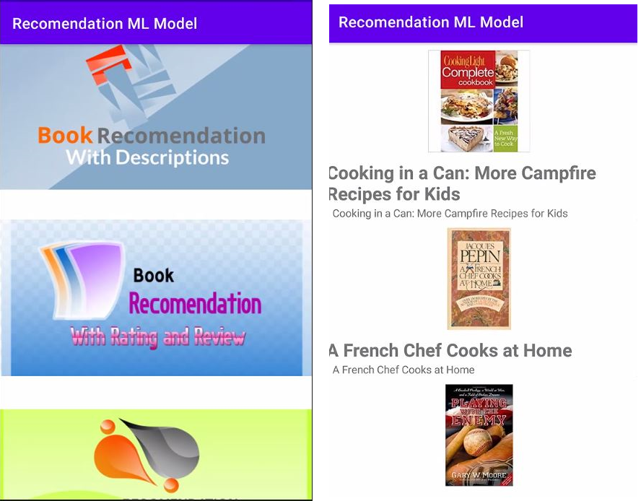

Slide 37
